Slide 1
Pronoun agreement
Grammar Unit #5

Slide 2
Pronoun
Definition: a word that can function by itself as a noun phrase and that refers either to the participants in the discourse (ex: I, you) or to someone or something mentioned elsewhere in the discourse (ex: she, it, they)
Subjective: pronoun that is the subject of the sentence – will do the action in the sentence.
Objective: pronoun that is the object of the sentence – will receive the action in the sentence.

Slide 3
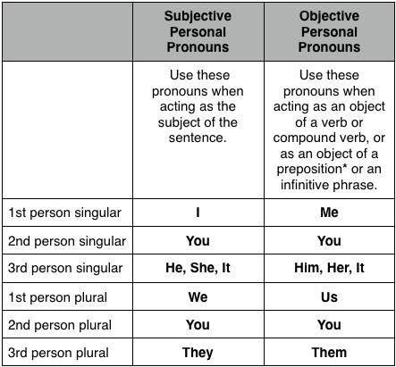

Slide 4
Each pronoun has a total of three items you should check for:
Does it agree with the noun it represents?(plural vs. singular)
Is it ambiguous?(open to more than one interpretation)
Does it use the right case? (subjective vs. objective)

Slide 5
Does it agree with the noun it represents?
A typical bank will reject an application for a home loan if their credit department discovers that the applicant has a poor credit history.
complete the following questions on the sentence above:
Where is the pronoun?
Where is the noun that the pronoun matches with?
Do they agree? If not, change the pronoun so it agrees with the noun.

Slide 6
PRONOUN – THEIR (PLURAL)
NOUN – BANK (SINGULAR)
DOES IT AGREE? NO (THEIR → ITS)

Slide 7
Is it ambiguous?
After the plane crash last year, they are training pilots in cockpit resource management.
Identify the pronoun.
Is it ambiguous? If so, how?

Slide 8
PRONOUN – THEY
IS IT AMBIGUOUS? YES, WE DO NOT KNOW WHO “THEY” ARE

Slide 9
DOES IT USE THE RIGHT CASE?
Her and the rest of the cast stopped by Fresh Choice for dinner after the rehearsal.
Where is the pronoun?
Is it correct? If not, what is the correct pronoun to use?

Slide 10
PRONOUN – HER
CORRECT? NO (SHE)
“HER” IS OBJECTIVE (RECEIVES ACT) AND “SHE” IS SUBJECTIVE (DOES ACT)
TIP: TRY CUTTING OUT “and the rest of the cast” and read it “Her stopped by Fresh Choice.”

